Slide 1

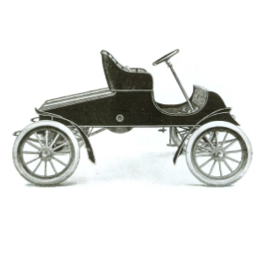
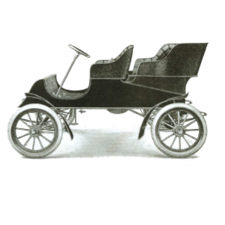

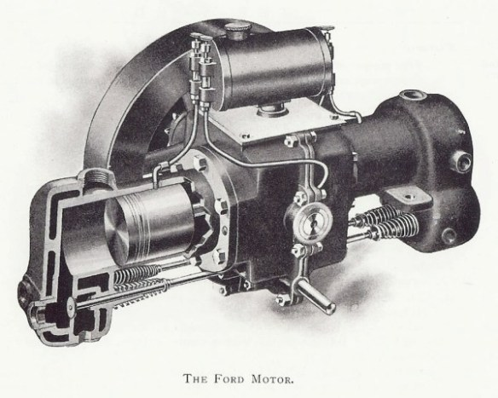
1903-1904 Ford Model A
Ford Motor Company’s 1st production model
Launched in 1903 with 2 cyl 8 hp engine; Updated in 1904 to 10 hp with other ‘improvements’ for durability
Assembled at Mack Avenue in Detroit with engine and chassis supplied by Dodge Bros
Available as 2 seater runabout or with optional rear tonneau
Production: 1903 - ~670; 1904 -~1140
Surviving: ~110
Runabout Price: $750-850; Ford Profit: ~$150
Optional Rear Tonneau cost $100 but increased Ford Profit by $50!
www.earlyfordregistry.org
Get more info on the Early Ford Letter Cars and join the EFR!
Ask us for more info or check out our website – we love to talk about our cars!

Slide 2
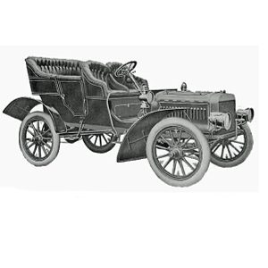
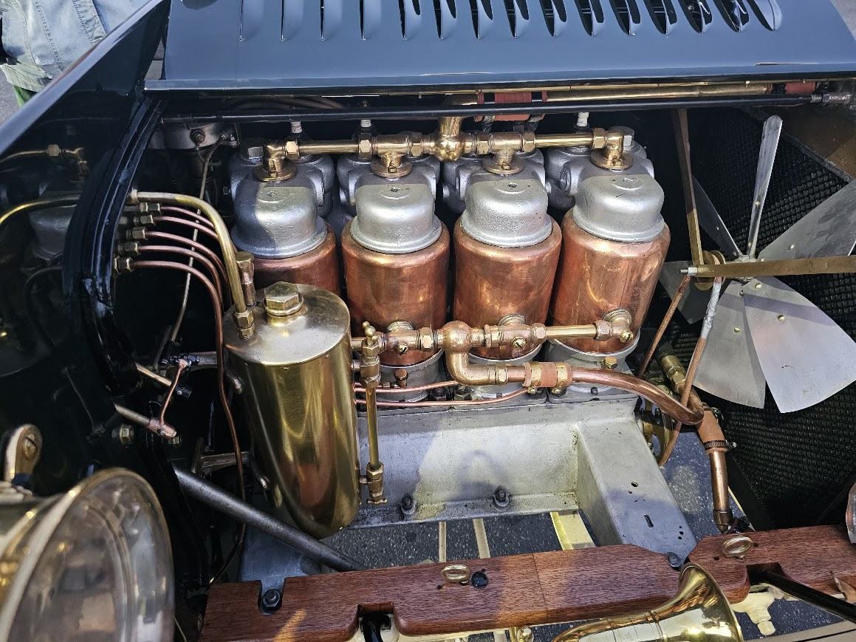
1904-1906 Ford Model B
Ford Motor Company’s 1st 4 cylinder, front engine model and Ford’s first step into larger cars
Ford Motor Company moved production to the Piquette Avenue Plant in December of 1904
Sales began in October 1904 and continued until July 1906
Production: ~500 total
Surviving: ~7 (the only running/touring Model B in the world is here!!!!)
Price: $2000
Ask us for more info – we love to talk about our cars!
Get more info on the Early Ford Letter Cars and join the EFR!
www.earlyfordregistry.org

Slide 3
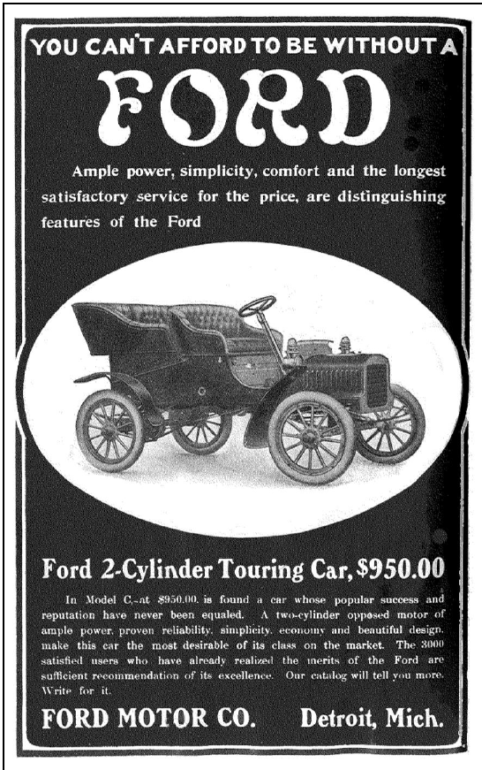
1904 - 1905 Ford Model C
An updated design and body style from the 10 hp Model A
Hood modernized style as well relocating and increasing the size of the gas tank for longer journeys and more ‘operator convenience’
Length of the car was increased
Production: ~870
Surviving: ~20
Price: $950;
Ask us for more info – we love to talk about our cars!
Get more info on the Early Ford Letter Cars and join the EFR!
www.earlyfordregistry.org

Slide 4
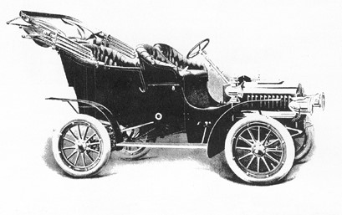
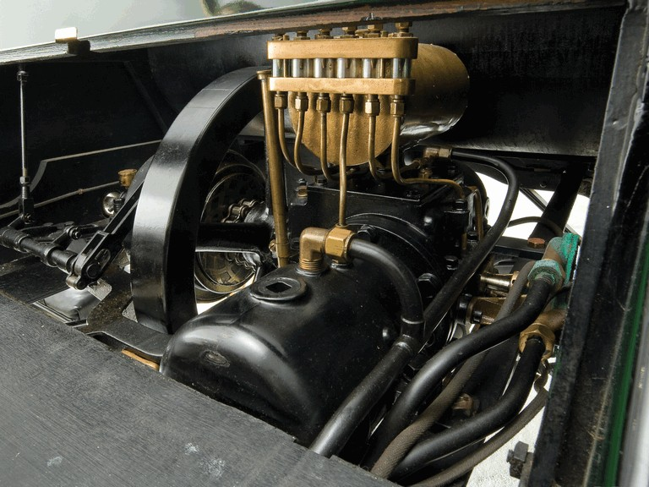
1905 - 1906 Ford Model F
Responding again to more driving and longer distances
Another engine upgrade – 2 cyl 12hp
Increased size of coolant tank and relocated to under the hood for ease of access
Increased wheel size for increased max speed
Production: ~1,250
Surviving: ~40
Price: $1,100
www.earlyfordregistry.org
Ask us for more info or check out our website – we love to talk about our cars!
Get more info on the Early Ford Letter Cars and join the EFR!

Slide 5
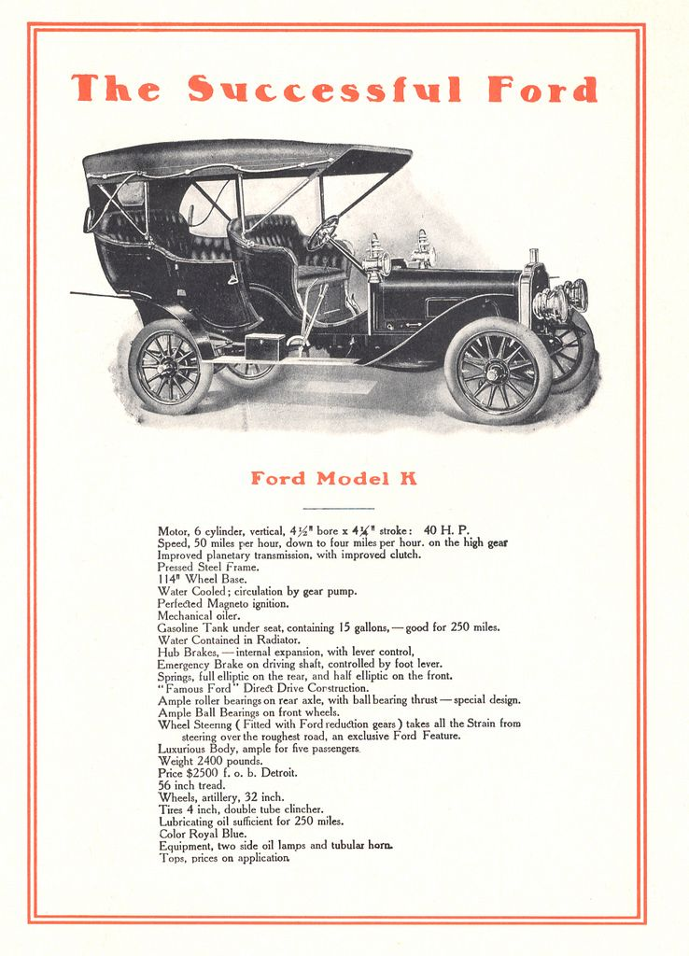
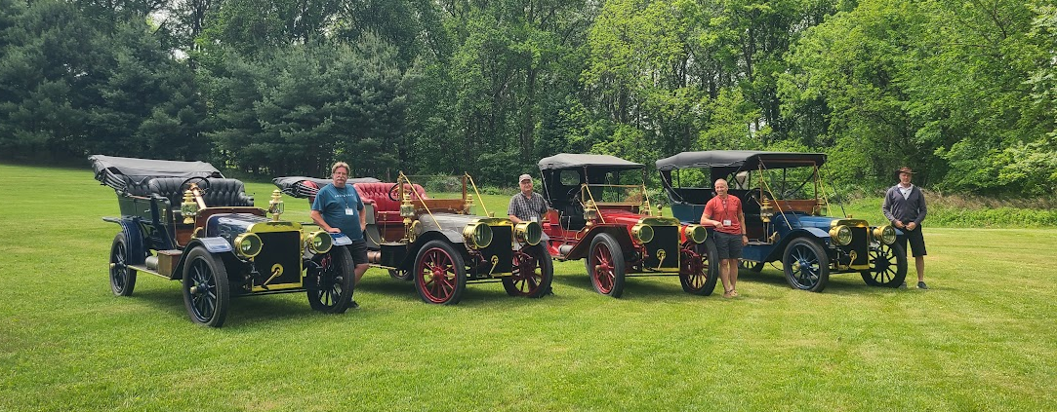
1906-1908 Ford Model K
Ford’s 2nd luxury car, building off the Model B, addressing it’s ‘weaknesses’ and adding Ford’s first inline 6 for power.
40hp 405 ci inline 6 cylinder engine
First production magneto
Featuring dual ignition systems
Available with Touring and Roadster body styles
Production: ~950
Surviving: ~ 28
Price: $2,800
Get more info on the Early Ford Letter Cars and join the EFR!
4 Model K’s often seen together on tour!
www.earlyfordregistry.org
Ask us for more info or check out our website – we love to talk about our cars!

Slide 6
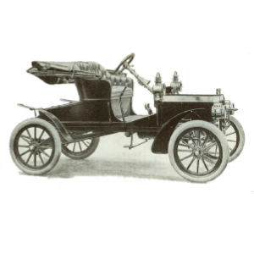
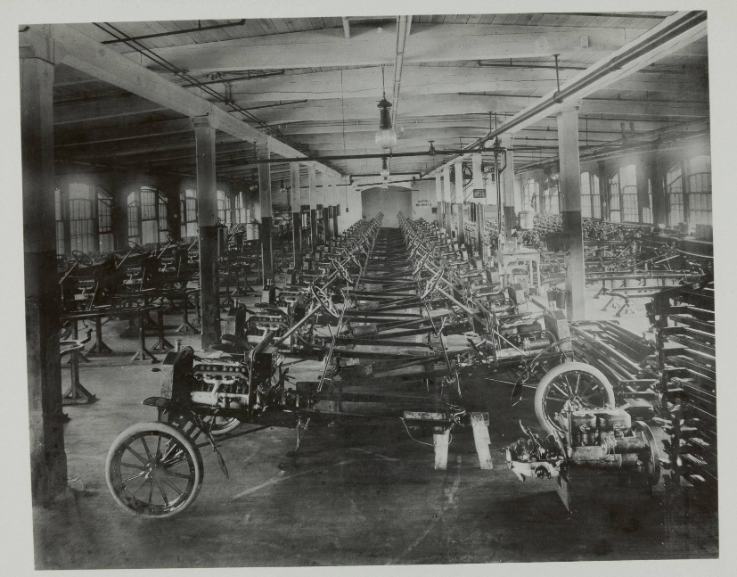
1906-1908 Ford Model N
Get more info on the Early Ford Letter Cars and join the EFR!
www.earlyfordregistry.org
Ford started on his quest to supply a ‘substantial’ car that was affordable in an automotive industry focused on large expensive cars
Model N was Ford’s largest selling model prior to the Model T starting Ford’s volume production
Featuring many clear mechanical similarities to the 1909 Model T and a few key differences the impact of the Model N on the Model T are clear. Meanwhile elements of the body style clearly reflect the pedigree from it’s predecessors, The A, C and F.
Production: ~7,000
Price: $500-600
Ask us for more info or check out our website – we love to talk about our cars!
Model N Chassis Assembly Room at Piquette Avenue Plant in Detroit, 1906

Slide 7
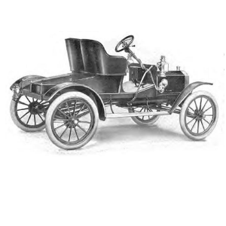
1907-1908 Ford Model R
www.earlyfordregistry.org
Produced concurrently to the Model N, with similar engine and chassis the Model R sought to deliver a more pretentious appearance
Featuring running boards, larger wheels, a wider body and rounded deck to enable carrying spare tire on top of the deck lid.
A notable difference in the engine is the use of a mechanical oiler vs the exhaust pressure driven oiler used on the N.
Demand for the R outstripped availability leading to the creation of the model S – a hybrid of the N and R!
Production: ~2,550
Price: $750
Get more info on the Early Ford Letter Cars and join the EFR!
Ask us for more info or check out our website – we love to talk about our cars!

Slide 8
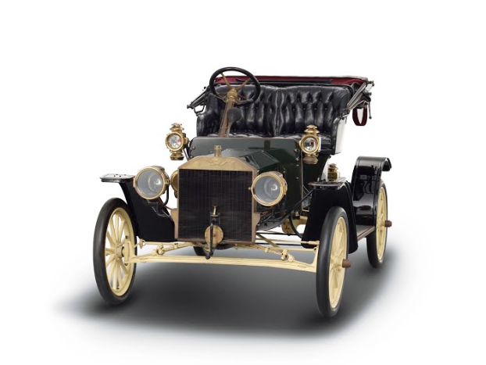
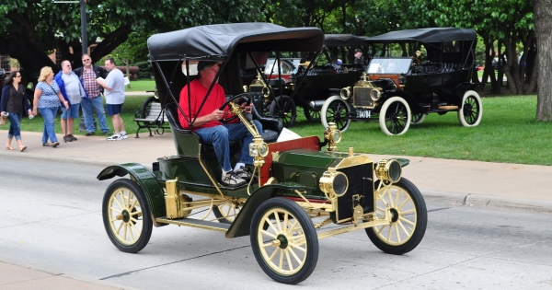
1907-1908 Ford Model S
www.earlyfordregistry.org
Demand for the appearance of the Model R outstripped availability of the larger wheels and wider bodies. Ford decided to offer a hybrid model using the body and wheels of the N, but engine, running boards, fenders and accessories of the R.
Production: ~2,350
Price: $700
Ask us for more info or check out our website – we love to talk about our cars!
Get more info on the Early Ford Letter Cars and join the EFR!

Slide 9
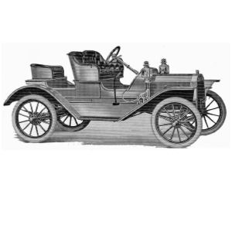
1908 Ford Model SR
www.earlyfordregistry.org
Introducing a ‘Mother in law’ for a 3rd passenger seat, splash aprons and a metal cowl the Model SR is another hybrid with the same wheel size as the Model R
The Model SR looks like a mini Model K roadster and was launched while the Model T was in planning stages
This model was so popular that over 3,600 cars were sold in the 12 months after it was launched
Production: ~3,710
Price: $750
Ask us for more info or check out our website – we love to talk about our cars!
Get more info on the Early Ford Letter Cars and join the EFR!

Slide 10
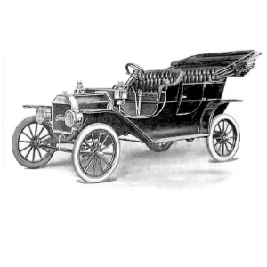
1908-1909 Ford Model T
www.earlyfordregistry.org
The beginning of the iconic Model T, building from the alphabet cars
In 1908 the Model T was launched with a new transmission, I4 engine with a removable cylinder head. Prototypes were developed on the Model N and S.
Many aspects of this design stayed consistent for the 15 million Model T’s produced.
Production: ~14,161 (first 15 months of production)
Price: $825
Ask us for more info or check out our website – we love to talk about our cars!
Get more info on the Early Ford Letter Cars and join the EFR!

Slide 11
Gathering of Ford Letter Cars
Ask us for more info or check out our website – we love to talk about our cars!
www.earlyfordregistry.org
Get more info on the Early Ford Letter Cars and join the EFR!

Slide 12
Gathering of Ford Letter Cars
Ask us for more info or check out our website – we love to talk about our cars!
www.earlyfordregistry.org
Get more info on the Early Ford Letter Cars and join the EFR!

Slide 13
Gathering of Ford Letter Cars
Ask us for more info or check out our website – we love to talk about our cars!
www.earlyfordregistry.org
Get more info on the Early Ford Letter Cars and join the EFR!

Slide 14
Gathering of Ford Letter Cars
Ask us for more info or check out our website – we love to talk about our cars!
www.earlyfordregistry.org
Get more info on the Early Ford Letter Cars and join the EFR!

Slide 15
Gathering of Ford Letter Cars
Ask us for more info or check out our website – we love to talk about our cars!
www.earlyfordregistry.org
Get more info on the Early Ford Letter Cars and join the EFR!

Slide 16
Gathering of Ford Letter Cars
Ask us for more info or check out our website – we love to talk about our cars!
www.earlyfordregistry.org
Get more info on the Early Ford Letter Cars and join the EFR!

Slide 17
Gathering of Ford Letter Cars
Ask us for more info or check out our website – we love to talk about our cars!
www.earlyfordregistry.org
Get more info on the Early Ford Letter Cars and join the EFR!

Slide 18
Gathering of Ford Letter Cars
Ask us for more info or check out our website – we love to talk about our cars!
www.earlyfordregistry.org
Get more info on the Early Ford Letter Cars and join the EFR!

Slide 19
Gathering of Ford Letter Cars
Ask us for more info or check out our website – we love to talk about our cars!
www.earlyfordregistry.org
Get more info on the Early Ford Letter Cars and join the EFR!

Slide 20
Gathering of Ford Letter Cars
Ask us for more info or check out our website – we love to talk about our cars!
www.earlyfordregistry.org
Get more info on the Early Ford Letter Cars and join the EFR!

